Slide 1
INFORMATION SECURITY PROJECT • GROUP 11
Secure Student Result Management System
Role-based academic portal ensuring confidentiality, integrity, and auditability of student examination records.
Submitted By (SE-B • Batch 2024)
Submitted To
Warisha Khan (24BSSW008) • Syed Naqi Haider Jafri (24BSSW074) • Syed M. Moiz Hussain (24BSSW072)
Dean Dr. Zahoor Shah

Slide 2
BACKGROUND & MOTIVATION
Solving Result Management Risks
Legacy Vulnerabilities
Proposed Secure Solution
Unauthorized Edits: Unprotected paper ledgers or spreadsheets
Role-Based Portals: Separate Admin, Teacher, Student workspaces
Manual Errors: Faulty percentage and grade calculations
Strict Validation: Reject negative or above-maximum marks
Zero Traceability: No audit trail for changed scores
Automated Grading: Instant totals, percentages, letter grades
Weak Access Control: Shared credentials expose sensitive records
Full Accountability: Dual audit logs and mark revision history

Slide 3
ENGINEERING DESIGN
Three-Tier Architecture & Stack
Presentation Layer
Application Logic
Relational Storage
HTML5, CSS3, Bootstrap 5, JS.
PHP 8.1+ on Apache (XAMPP).
MySQL / MariaDB InnoDB (13 tables).
13 Tables
PDO Prepared
3 User Roles
Normalized utf8mb4 Schema
Emulated Prepares Disabled
Strict RBAC Enforcement

Slide 4
DEFENSE IN DEPTH
Core Security Mechanisms
Authentication & Lockout
Server-Side RBAC & Sessions
Bcrypt password hashing; 15-minute lockout after 5 failures.
Strict ResultHub session ID regeneration and HTTP 403 checks.
CSRF, XSS & SQLi Prevention
Dual Accountability Logs
hash_equals() CSRF tokens, htmlspecialchars(), parameterized PDO.
audit_logs tracks IP events; result_history tracks score edits.

Slide 5
AUTHORIZATION POLICY
Role-Based Access Control Matrix
System Capability | Administrator | Teacher | Student
Manage Users, Subjects & Classes | Full Access | Denied | Denied
Assign Teachers & Enroll Students | Full Access | Denied | Denied
Enter & Update Examination Marks | Denied | Assigned Scope Only | Denied
View Mark Modification History | All Records | Own Revisions | Denied
View Personal Result & Print PDF | Class Reports | Denied | Own Results Only
Inspect System Security Audit Log | Latest 300 Events | Denied | Denied

Slide 6
LIVE APPLICATION EVIDENCE
System Walkthrough & Visual Walkthrough
Exploring actual screenshots across Administrator, Teacher, Student, and Security Validation workflows.

Slide 7

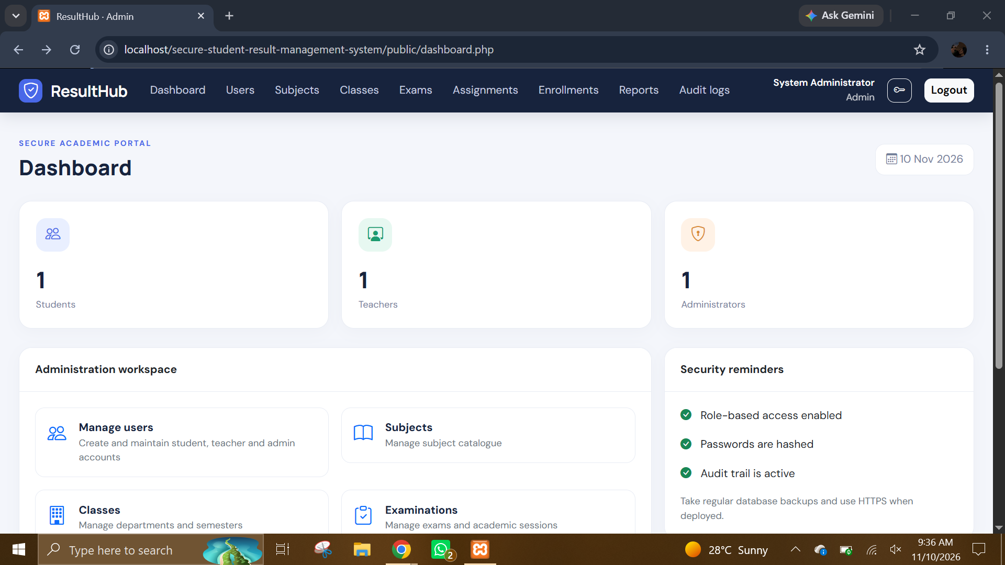
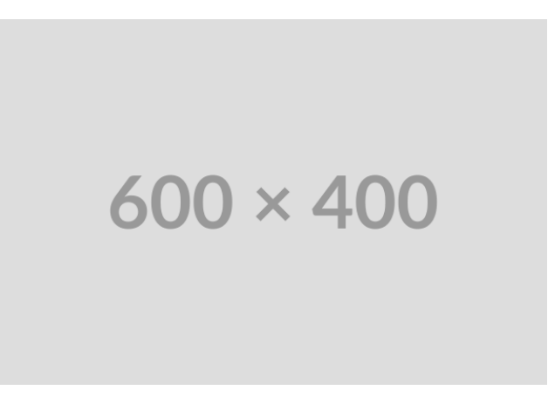
ADMINISTRATOR MODULE • SCREENSHOTS 1 & 2
Unified Login & Admin Dashboard
What This Screen Shows
ResultHub Admin Dashboard displaying live counts of students, teachers, and administrators.
Centralized Oversight
Provides quick workspace shortcuts to accounts, courses, exams, and audit logs.
Security Posture
Highlights active session isolation and reminds staff of password hygiene.

Slide 8

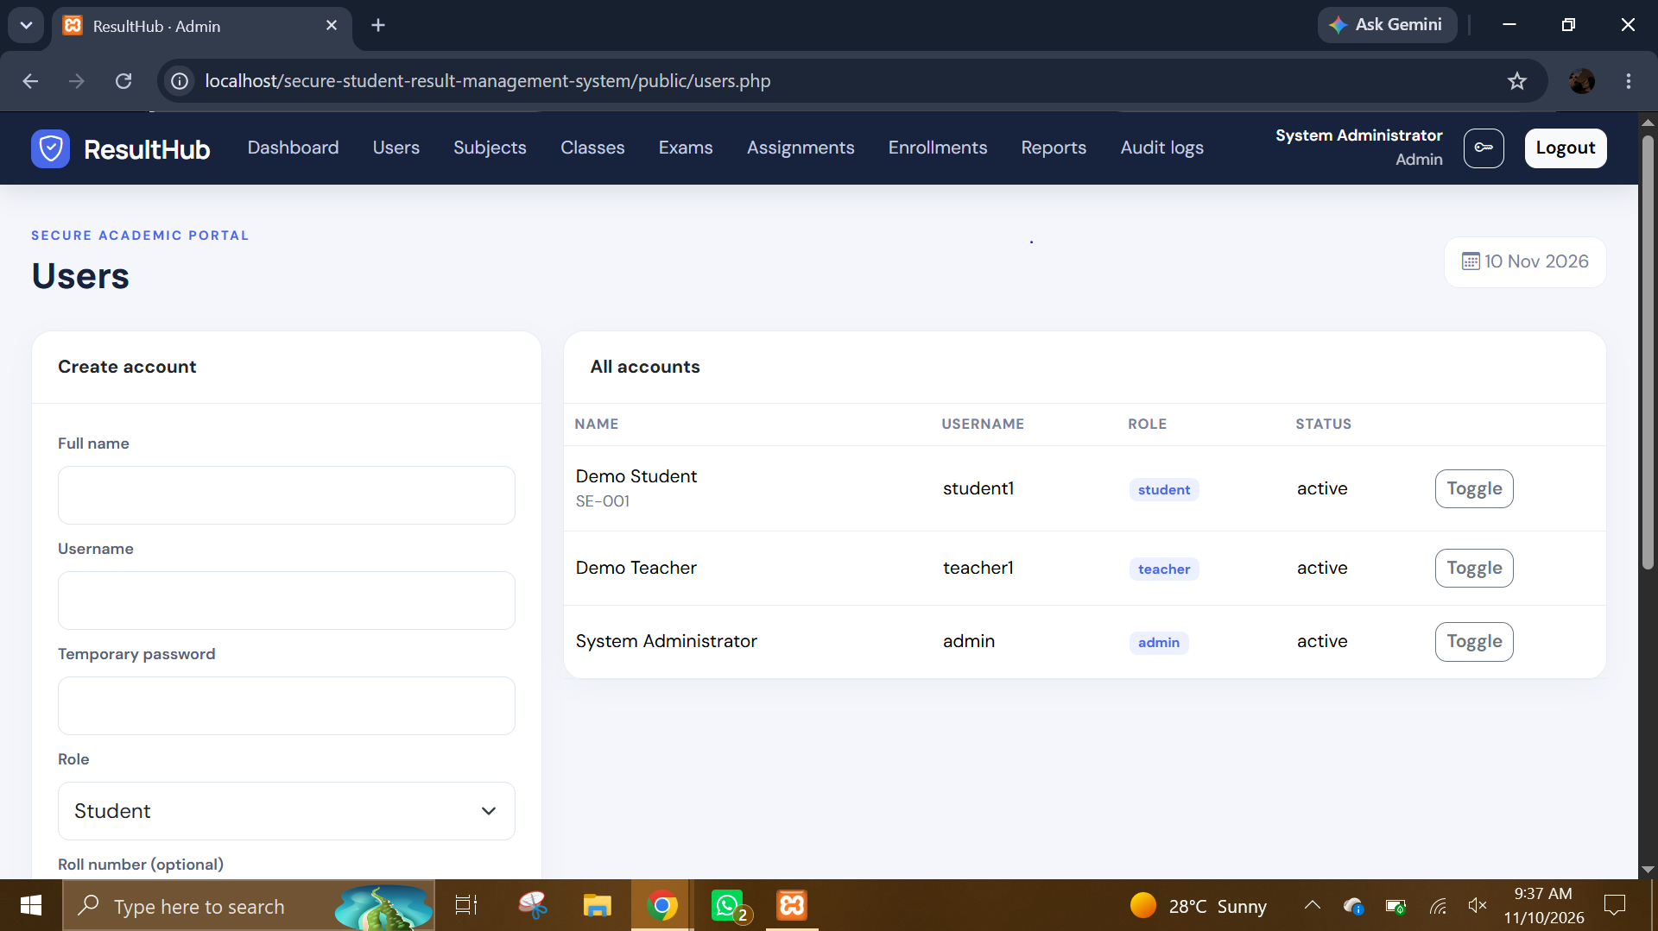
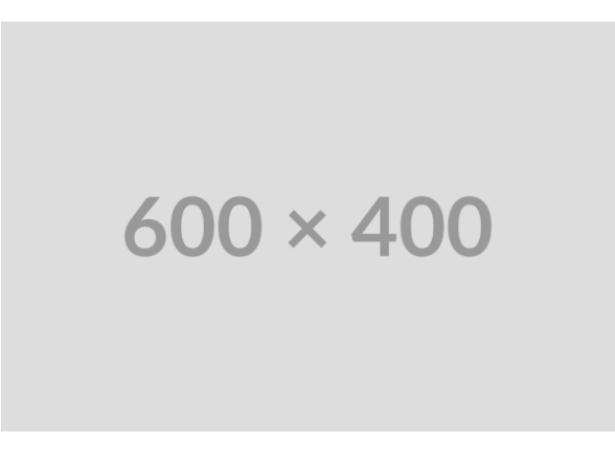
ADMINISTRATOR MODULE • SCREENSHOTS 4 & 10
Account Control & Teacher Scope
User Provisioning
Creates accounts with assigned roles, unique roll numbers, and active/inactive toggles.
Least-Privilege Binding
Binds specific teachers to exact subject and class combinations.
Referential Integrity
Enforces unique constraints so duplicate enrollments or assignments cannot occur.

Slide 9
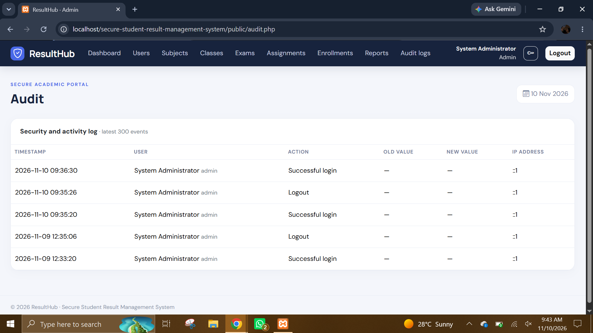

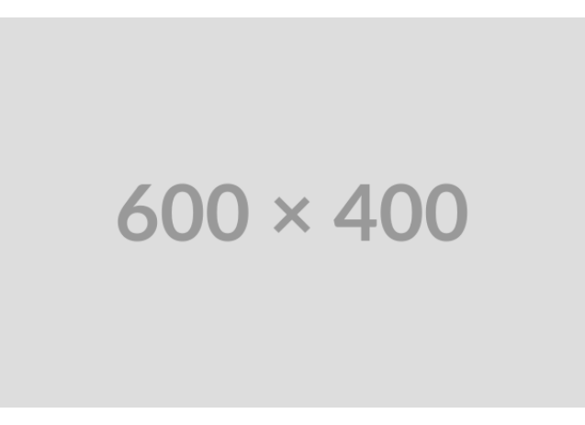
ADMINISTRATOR OVERSIGHT • SCREENSHOT 13
Real-Time Security & Activity Audit Log
Forensic Traceability
Logs exact timestamp, actor identity, action type, and client IP address.
Before & After Values
Captures old_value and new_value on mark edits and status changes.
Non-Repudiation
Displays up to 300 recent events for immediate administrative review.

Slide 10
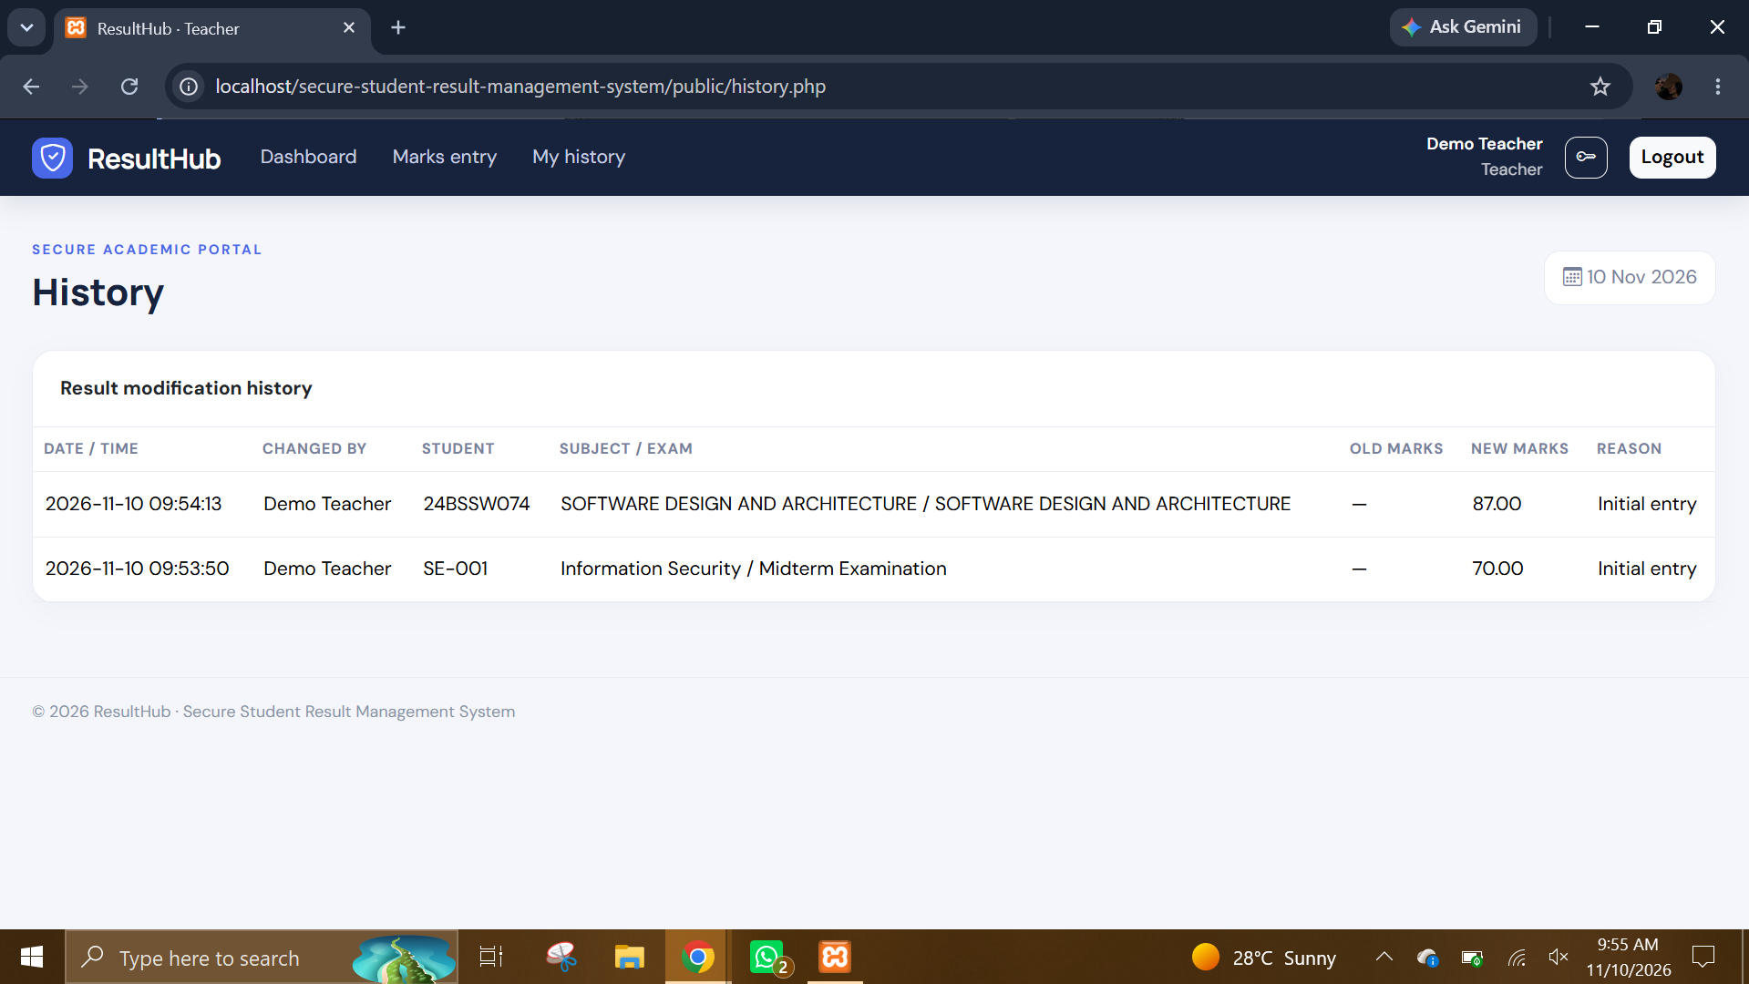
TEACHER WORKFLOW • SCREENSHOT 17
Scoped Mark Entry & Revision History
Strict Assignment Filter
Teachers only load rosters for their assigned subjects and classes.
Transparent Mark Revisions
Populated history table records old marks, new marks, and edit reasons.
Tamper Deterrence
Every score update automatically inserts an immutable result_history row.

Slide 11
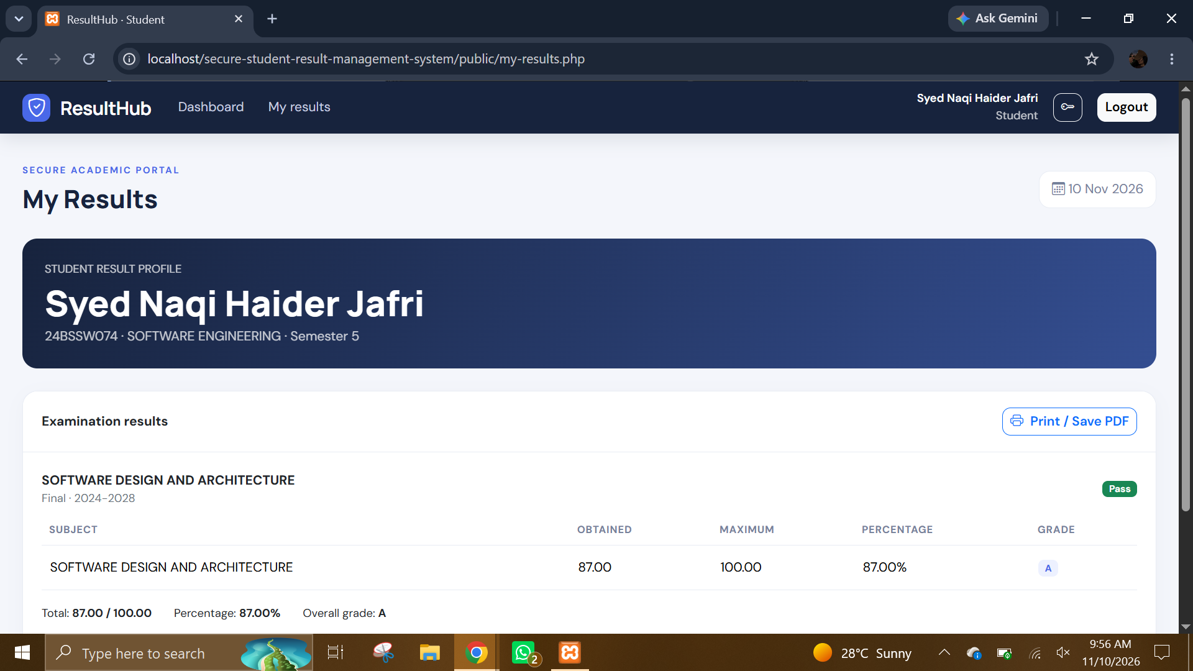
STUDENT PORTAL • SCREENSHOTS 21 & 22
Read-Only Result Card & PDF Export
Data Isolation
Queries bind directly to the authenticated student_id—zero cross-student leakage.
Automated Calculations
Computes subject percentages, total score, letter grade (A+ to F), and Pass/Fail.
Print & Save PDF
One-click browser print formatting generates official result transcripts.

Slide 12

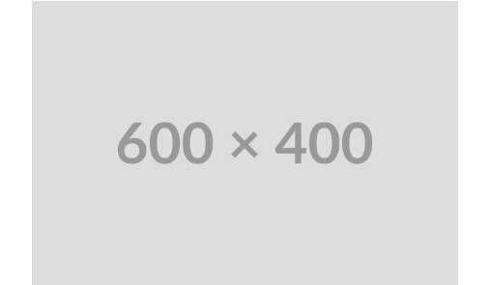

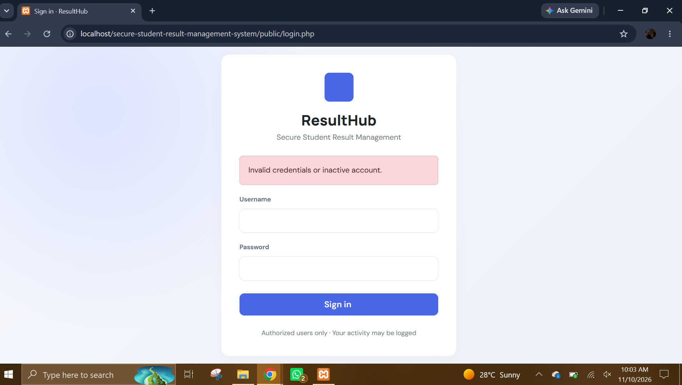
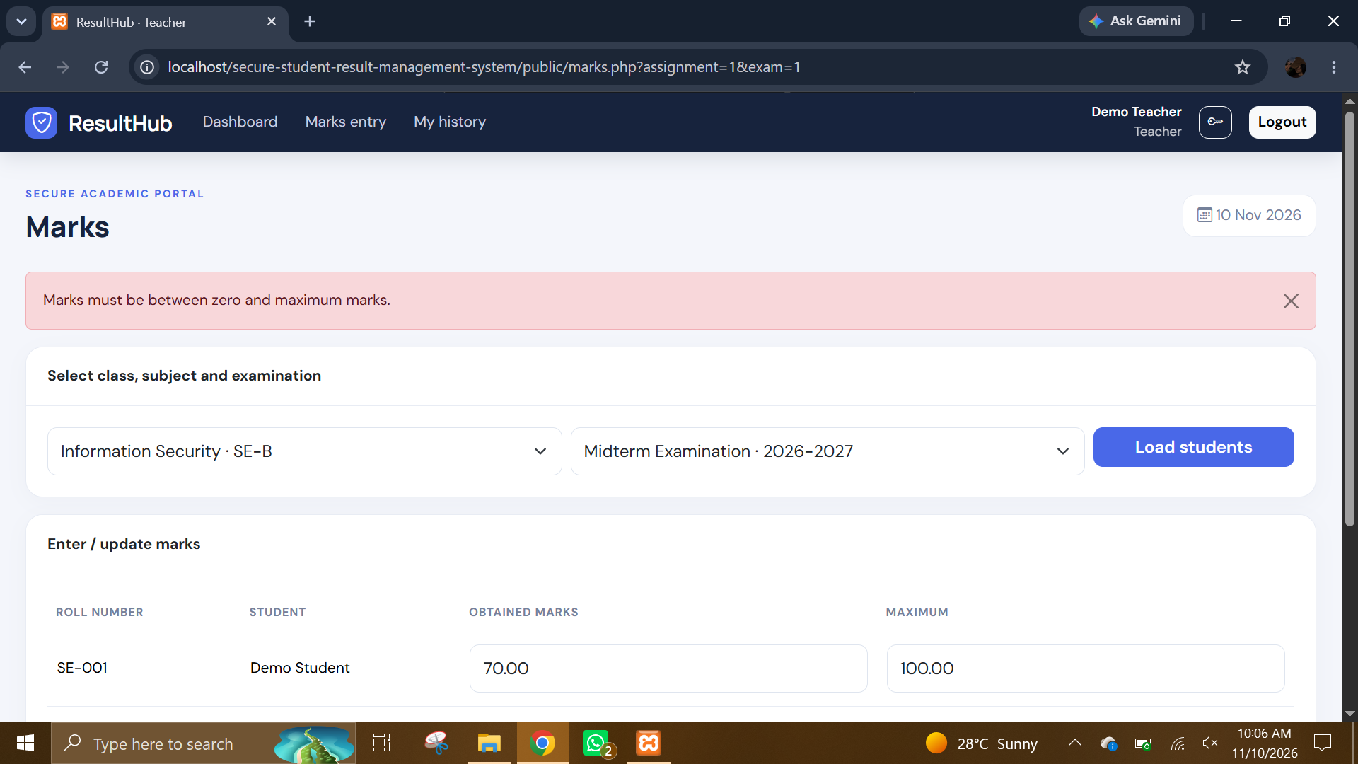
SECURITY TESTING EVIDENCE • SCREENSHOTS 23 & 24
Authentication & Input Boundary Rejection
TC-02: Invalid Credentials Blocked
TC-05: Out-of-Range Marks Rejected
Rejects wrong passwords or deactivated users without leaking account details.
Rolls back database transactions when obtained marks exceed total marks.

Slide 13
EVALUATION & EVOLUTION
Grading Logic & Future Enhancements
Production Hardening & Roadmap
Grade | Percentage Range | Status
A+ / A | 80.00% – 100.00% | Pass (Distinction)
B / C | 60.00% – 79.99% | Pass (Merit)
D / E | 40.00% – 59.99% | Pass (Threshold ≥40%)
F | 0.00% – 39.99% | Fail
Roster Revalidation: Verify student_id enrollment on POST
Two-Factor Auth: TOTP verification and HTTPS enforcement
GPA / CGPA Engine: Credit-hour weighted semester analytics
Automated Backups: Scheduled off-site database snapshots

Slide 14
Thank You & Questions
Securing academic integrity through role-based access control, strict validation, and complete auditability.
Project Repository & Team
github.com/naqi123-4/secure-student-result-management-system

